Slide 1
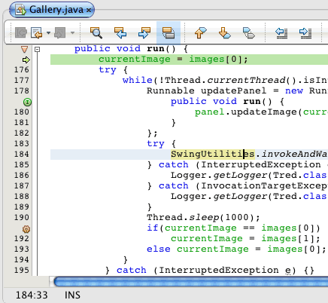

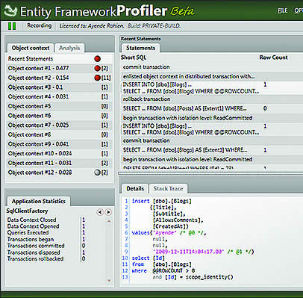
Style & Syntax
Advanced Games Programming (CGP600)

Slide 2
Overview
Why use constants?
What is the difference between references and pointers?
static or member functions?
What are magic numbers?
What are comments for?
Who will read your code?

Slide 3
Example

Slide 4
Which way is best and why?
All the examples would work – but which is most suitable and most importantly why?

Slide 5
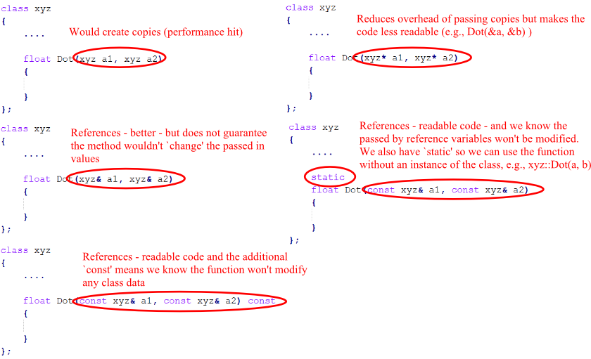
Review Examples

Slide 6
Clarity
Ensure each section of your code is transparent (easy to understand)
Ask another person (who is unfamiliar with your subject and code) to review or comment on what it does
Did you need to explain it to them?
Did they understand it without any help or input?

Slide 7
Summary
Write readable clean code
Industry standard
Code should be self-checking (reduce abuse/catch errors)
Demonstrate an understanding of the language and tools (e.g., visual studio/system resources/debugging/testing)

Slide 8
To do this week...
Read over the lectures
Practicals
Get started with versioning control
Project aspect – should be able to setup a basic project without difficulty
Profiling/memory usage/asserts/warnings

